Slide 1
Human Activity and Postural Transition Recognition using DNN
Laboratory Course Artificial Intelligence: Deep learning lab – WS22
Benedikt Rotter
Ravi Akash
Univ.-Prof. Dr. rer. nat. Steffen Staab
Amin Totounferoush
Yuqicheng Zhu, Yunjie He

Slide 2

Introduction

Slide 3
Introduction
Project description
Dataset: Human Activities and Postural Transitions Data set
Data from tri-axial accelerometer and gyroscope
Feature vectors and raw data available
Six basic activities and six postural transitions
Tasks:
Try conventional machine learning methods
Try more sophisticated deep learning models
Compare different architectures, models, optimizers, hyperparameter settings and loss functions
Challenges
Unbalanced dataset

Slide 4
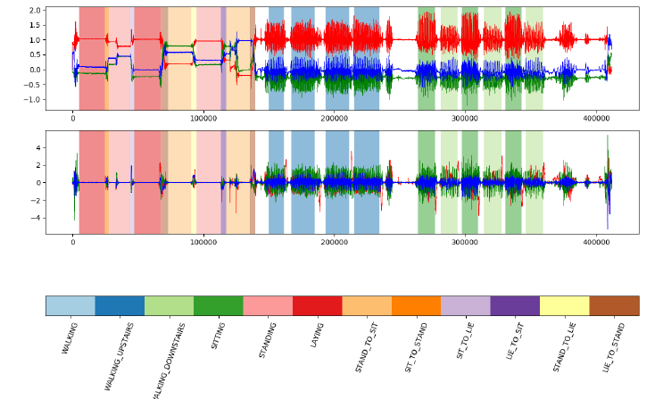
Introduction
Project description

Slide 5
Methodology

Slide 6
Methodology
Evaluated models
1D-Cnn
LSTM

Slide 7
Initial Results

Slide 8
Initial Results
Hyperparameter optimization
Bayesian optimization

Slide 9
Initial Results
Comparison different architectures
 | Accuracy | Training Time
1D-CNN
LSTM
CNN-LSTM

Slide 10
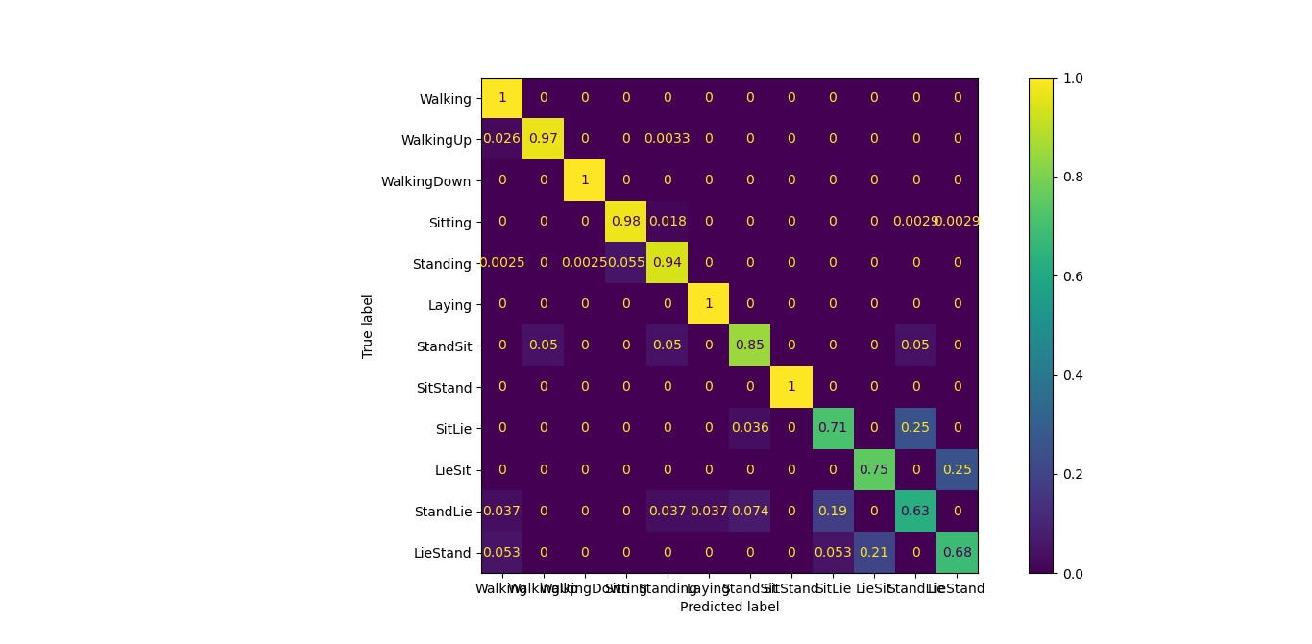
Initial Results
Confusion Matrix - LSTM

Slide 11
Further Steps

Slide 12
Further Steps
Improve performance for postural transitions
Few shot learning
Implementation of a conventional machine learning method (SVM)
Test transformer architecture
Include validation
Balancing dataset
Augmentation
Oversampling

Slide 13
Ravi Akash
Benedikt Rotter
E-Mail
st174840@stud.uni-stuttgart.de
E-Mail
st175376@stud.uni-stuttgart.de
Telefon +49 15206073464
Telefon +49 15735324701
Matriculation Number: 3506815
Matriculation Number: 3524570
Universität Stuttgart
Faculty V INFOTECH - Embedded Systems
Laboratory Department: Analytic Computing - Institut für Parallele und Verteilte Systeme
Address: Universitätsstraße 32 70569 Stuttgart

